Slide 1

Pathogensurveillance: An Automated
Computational Pipeline for Identification,
Population Genomics, and Monitoring of
Pathogens
Zachary Foster, Camilo Parada-Rojas, Martha Sudermann, Fernanda Bocardo, Ricardo Alcala-Briseno, Hung Phan, Marina Witherell, Alexandra Weisberg, Melodie Putnam, Jeff Chang, Niklaus Grünwald

Slide 2
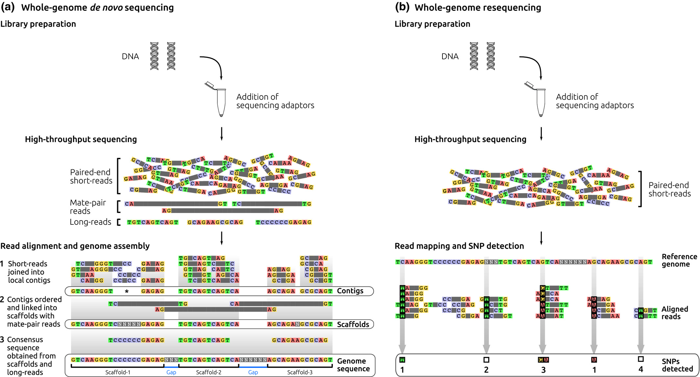
Whole genome sequencing review
Image credit: Whole-genome sequencing approaches for conservation biology: Advantages, limitations and practical recommendations. Angela P. Fuentes-Pardo, Daniel E. Ruzzante

Slide 3
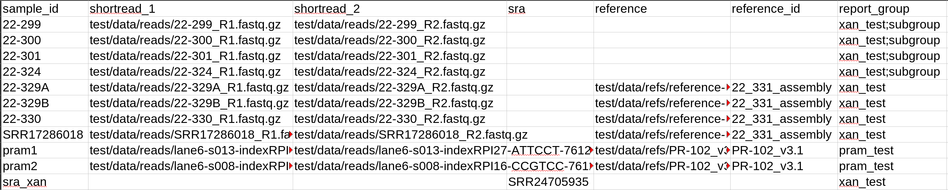
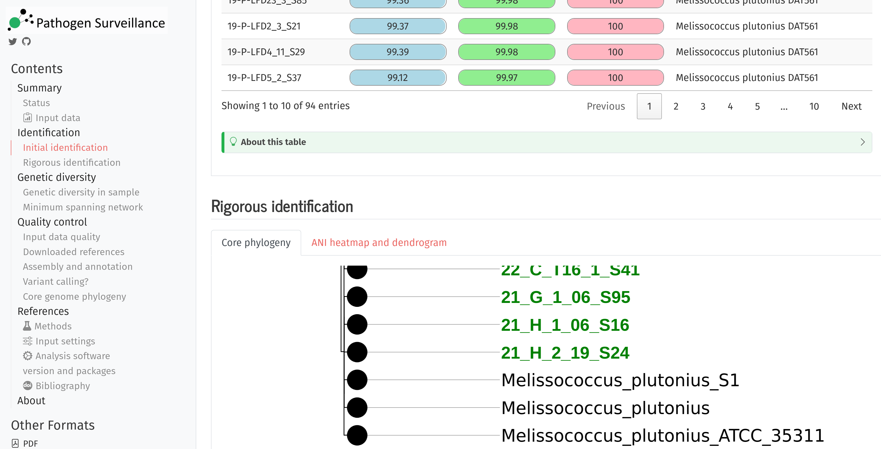
Introducing pathogensurveillance
Software to bulk analyze raw whole genome sequencing data
Takes raw reads as input
Outputs PDF/HTML reports with plots/tables
Works on unknown organisms
Works on eukaryotes and prokaryotes
Designed to be as simple to use while still being useful for advanced users
Can be run without command line
Easy to install
Can be run on clusters, commercial clouds, and personal computers

Slide 4
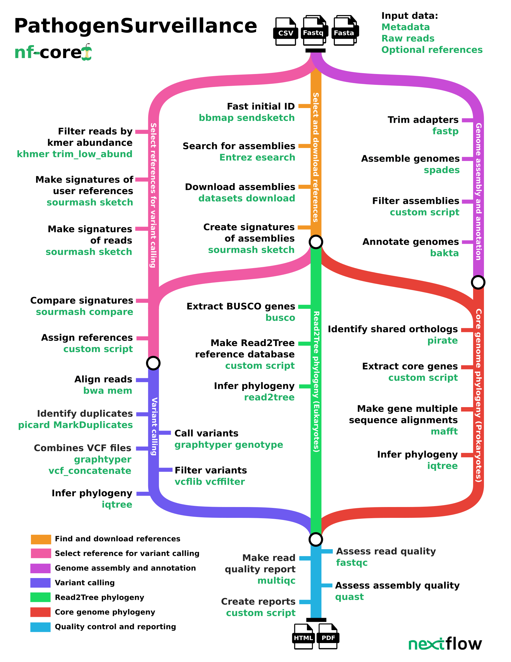
What pathogensurveillance does
Identifies unknown organisms
Compares organisms to similar publicly available reference genomes
Compares groups of organisms to each other
Outputs results as human-friendly HTML or PDF reports for each user-defined group of genomes
Outputs intermediate data for use by advanced users
Runs in parallel whenever possible and caches past results

Slide 5
What the input looks like
A CSV table with paths to input files
Paths can be local or online URLs
Only some columns are needed and can be in any order
The `report_group` column is used to group samples
Some columns accept NCBI accession numbers instead of paths/URLs

Slide 6
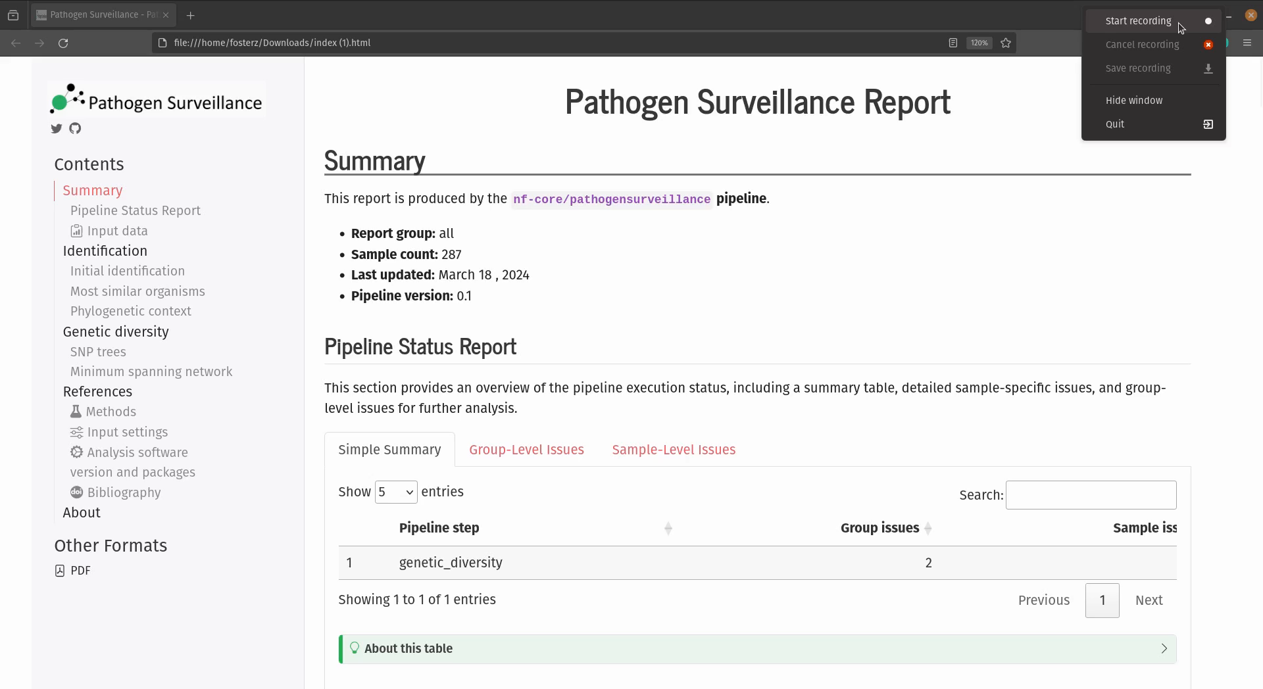

Slide 7
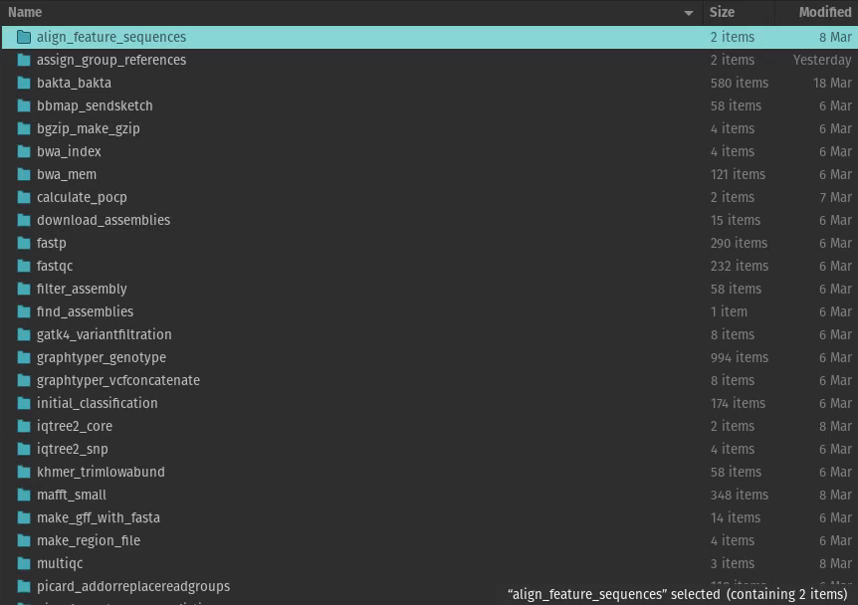

Slide 8
Future directions
Finish the report output
Identify presence of genes of interest
Map samples with the location of similar organisms in public databases
Accept long read and hybrid sequencing
Genome assembly and annotation of eukaryotes
Handle host DNA correctly for samples from infected tissue
Explore contamination/metagenomics (e.g. viruses)

Slide 9
Acknowledgments
Programmers:
Camilo Parada-Rojas
Martha Sudermann
Ricardo Alcala-Briseno
Hung Phan
Testers:
Marina Witherell
Pipeline analysis design:
Fernanda Bocardo
Alexandra Weisberg
Consulting:
Melodie Putnam
Alexandra Weisberg
Project leadership:
Niklaus Grünwald, Jeff Chang

Slide 10
How the pipeline is run: on the cloud (interactive)
To launch the pipeline:
https://tower.nf/orgs/Grunwaldlab/workspaces/Pathogen_Surveillance/launchpad/103974793792958/form
To view the results:
https://tower.nf/orgs/Grunwaldlab/workspaces/Pathogen_Surveillance/watch/50erjDlrFUit3

Slide 11
Using whole genome sequencing data in plant pathology
Whole genome sequencing presents both opportunities and challenges when compared to gene-based methods such as (q)PCR, SSRs, and gene sequencing.
Potential:
Increasingly abundant and cheap
Increasingly reliable
Less biased against unknowns
High resolution
More information
Less dependent on experimental design
More relevant in the future
Challenges:
Still more expensive then gene-based methods
Large data sets
Difficult to analyze and interpret
Computationally expensive to analyze
Lower throughput

Slide 12
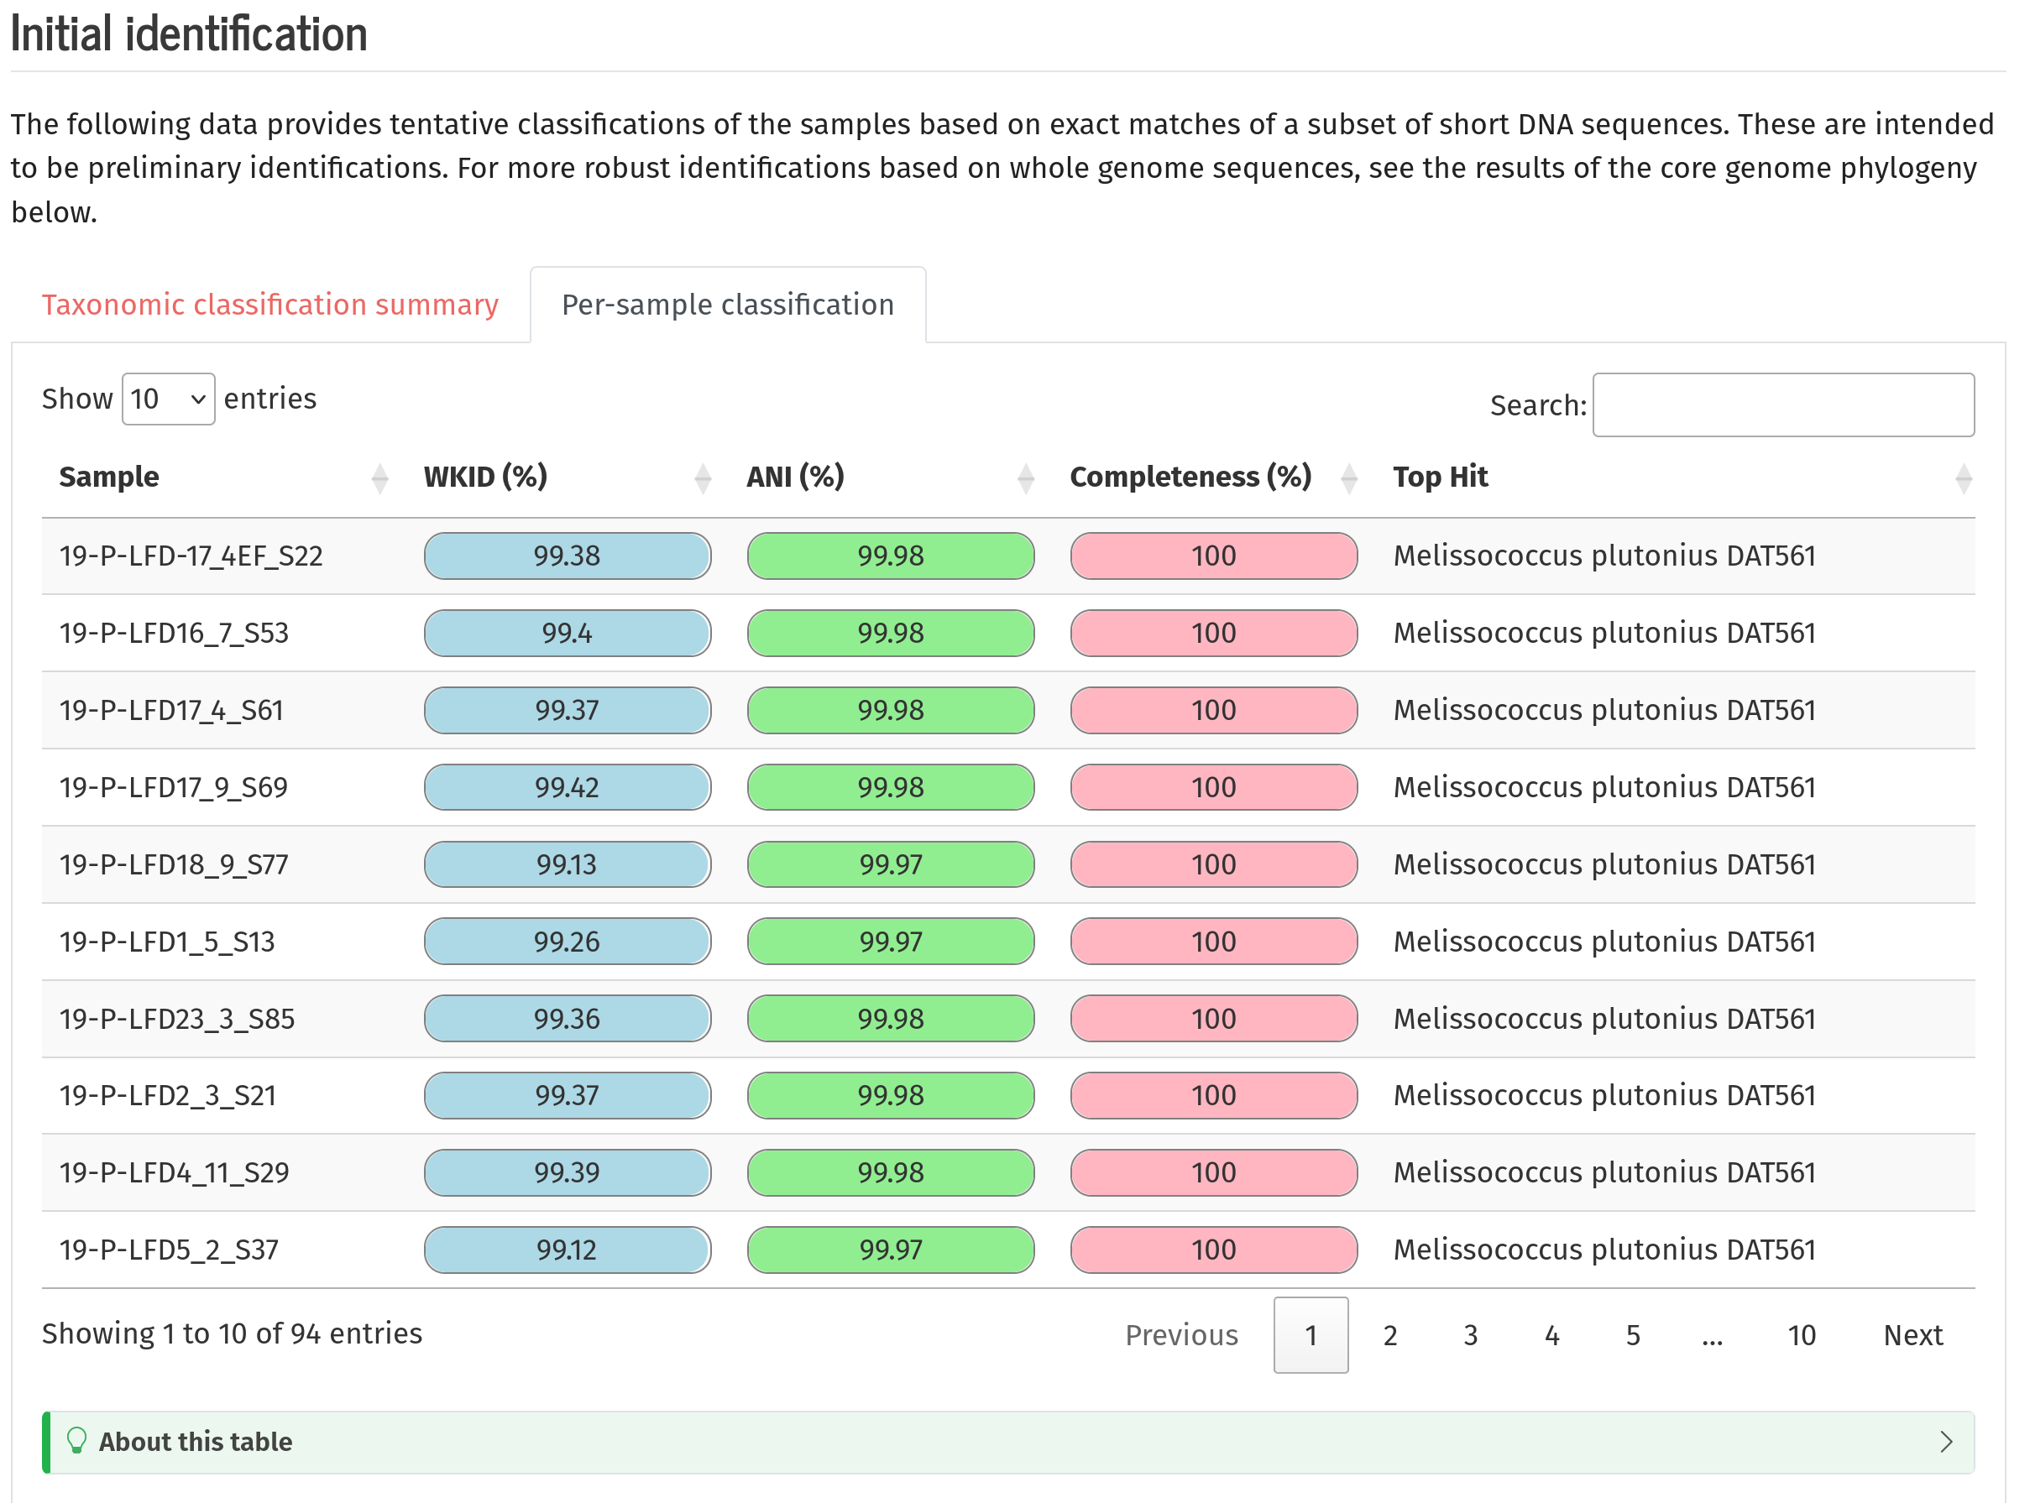
Initial identification
Example HTML output:

Slide 13
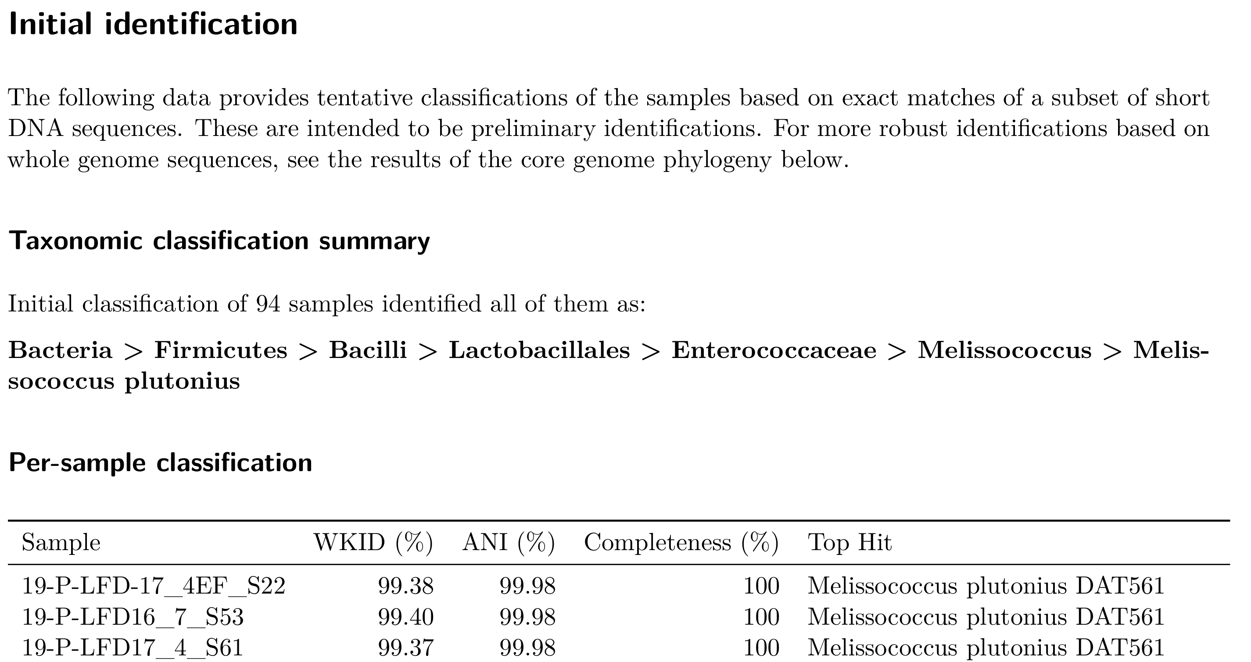
Initial identification
Example PDF output:

Slide 14
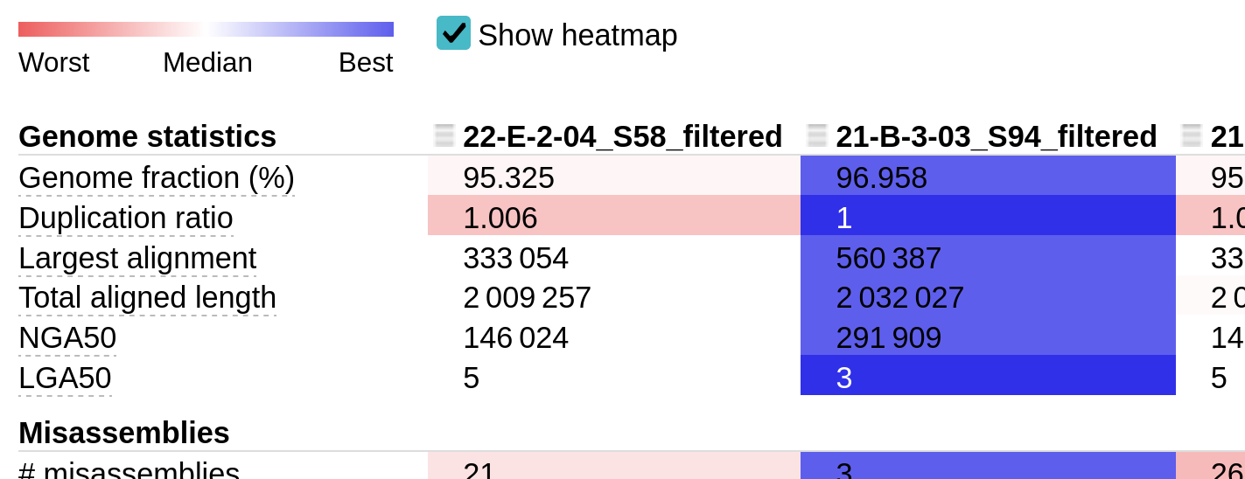
Genome assembly and annotation
De novo assembly and annotation
Used for the core genome phylogeny
Useful as a starting point for project-specific analyses
Currently only working for prokaryotes and short reads

Slide 15
Automated reference selection
Reference genomes are used place samples into context of known organisms as well as exploring fine-scale differences between samples (variant calling)
References for phylogenetic context are selected and downloaded automatically
References for variant calling can be defined by the user or selected automatically
All of NCBI RefSeq is used to find appropriate references based on the initial identification

Slide 16
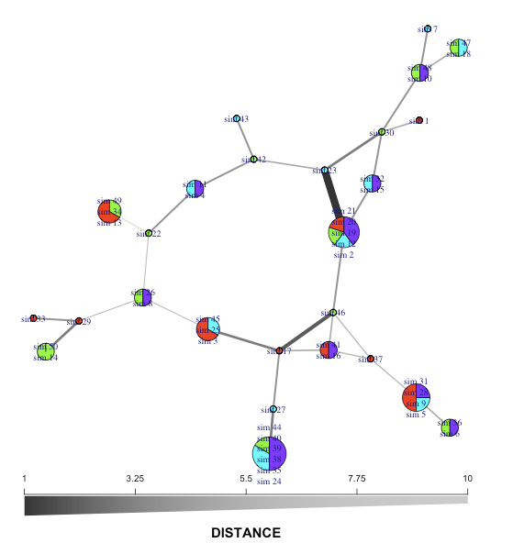
Variant calling: high-resolution comparison of samples
Reads from all samples are aligned to a reference genome
How samples differ from the reference informs how they differ from each other
Allow for single SNP distinctions between gnomes

Slide 17
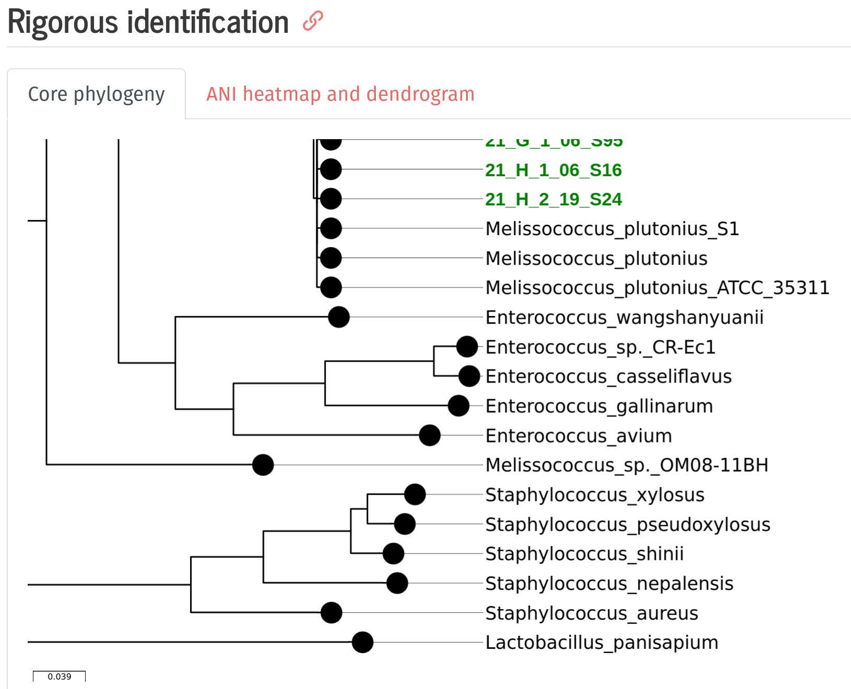
Core gene phylogeny: robust phylogenetic placement
Example HTML output:

Slide 18
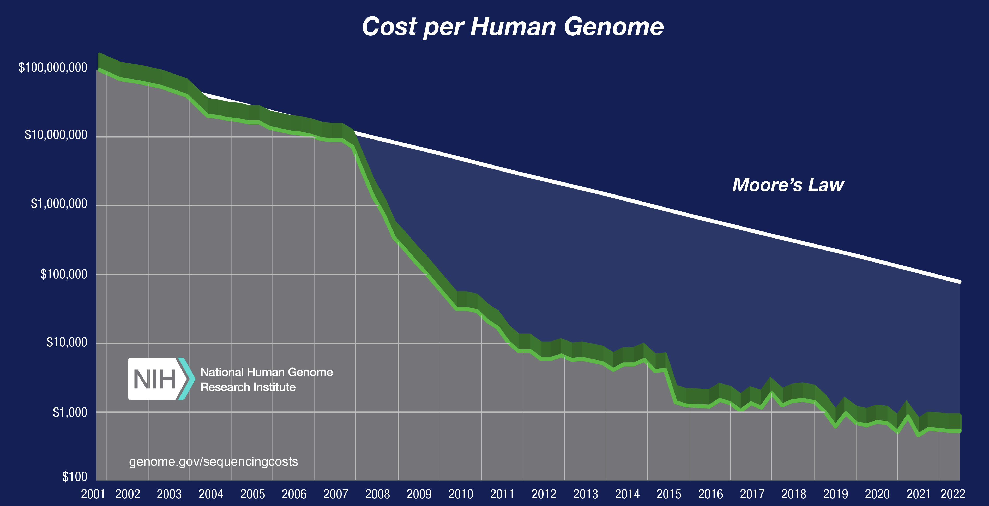
Whole genome sequencing review
Image credit: https://www.genome.gov/about-genomics/fact-sheets/DNA-Sequencing-Costs-Data

